Slide 1
Enhancing Loan Approval with Predictive Modeling
By IBUKUNOLUWA OLUKOKO - 301259629

Slide 2
Content Of This Presentation
INTRODUCTON | MODELS EXECUTED
PROBLEM STATEMENT | EXECUTED MODEL RESULTS
DATA EXPLORATION | MODEL SELECTION / KEY DRIVERS
INITIAL DATA OVERVIEW | RECOMMENDATION
VISUALIZING AND HANDLING CLASS IMBALANCE | NEXT STEP AND FUTURE ENHANCEMENTS
DATA CLEANSING | QUESTIONS

Slide 3

INTRODUCTION
Introduction:
  The allocation of loans is a pivotal function within banks, significantly impacting profitability.
  Despite verification protocols, uncertainties persist in the loan approval process.
  Enhance fairness, transparency, and efficiency in decision-making.
Challenges:
  Complex decision-making process.
  Need to identify creditworthy applicants.
  Mitigate the likelihood of loan defaults.
Objective:
  Develop a predictive model for loan applications.
  Accurately evaluate applications for approval or rejection.

Slide 4
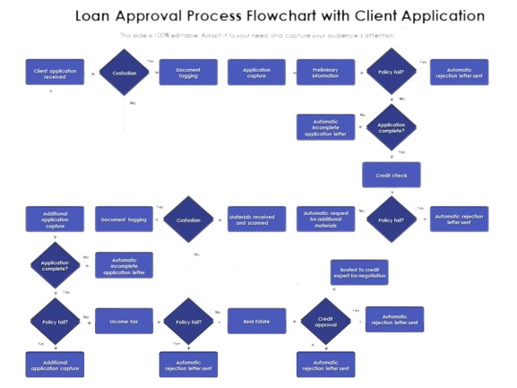
Problem Statement
The Focus:
  Create a robust model to make informed loan approval decisions.
  Precision in evaluating loan applicants' creditworthiness.
  Predictive power to minimize any potential risks.
Value:
  Improve decision-making quality.
  Improved customer satisfaction and loyalty.
  Expedited loan approval cycles.

Slide 5

Problem Statement cont.
Assumptions:
  Availability of sufficient variables for the predictive model.
  Representative dataset from the target population.
  Reliable and accurate historical loan data.
Limitations:
  Model's accuracy tied to data quality and quantity.
  Vulnerability to economic and industry changes.
  Potential exclusion of external factors impacting repayments.
  Possible biases in historical data.
Rationale for F1 Score and ROC AUC:
  F1 Score balances precision and recall, ideal for unbalanced data.
  ROC AUC evaluates model's ability to discriminate between classes.

Slide 6
Data Exploration Approaches
Initial Data Overview:
Importance: Understand the dataset's structure and attributes.
Why: Provides an overview of available data for effective analysis and modeling.
2. Handling Class Imbalance:
Importance: Understand distribution of target variable (loan approvals and rejections).
Why: Ensures model's ability to generalize well to both approval and rejection cases.
3. Visualizing Class Imbalance:
Importance: Visualize proportion of approved vs. rejected loans.
Why: Raises awareness about data imbalance, guiding preprocessing and model evaluation.
4. Exploring Unique Values:
Importance: Identify categorical attributes and their diversity.
Why: Helps in preprocessing and handling categorical data for modeling.
5. Visualizing Numeric Data:
Importance: Gain insights into numeric feature distributions.
Why: Identifies potential patterns and outliers, aiding feature selection and engineering.

Slide 7
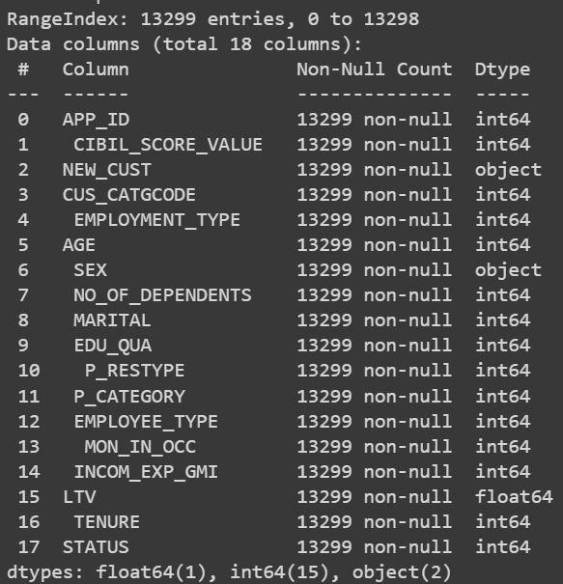
Initial Data Overview
The data was obtained from Banking loan approval info for a Nationalized Bank. AT KAGGLE.COM

Slide 8
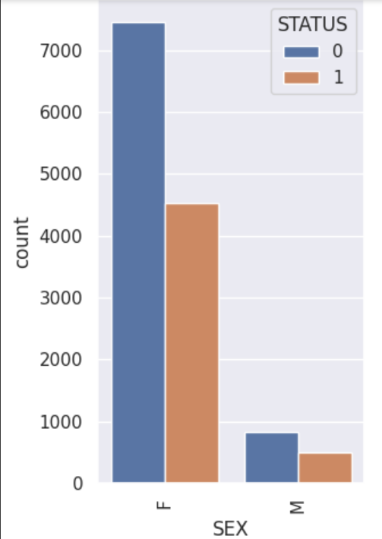
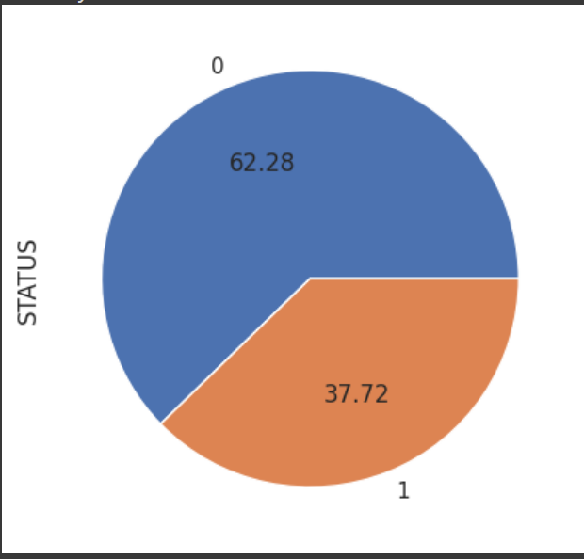
Visualizing And Handling Class Imbalance
0 = REJECTED AND 1 = ACCEPTED

Slide 9
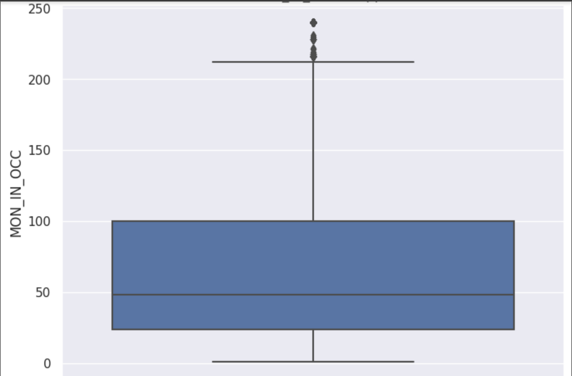
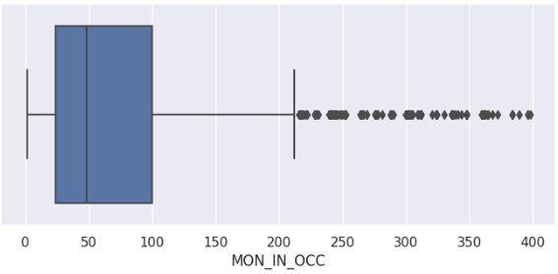
Data Cleansing
Handling Outliers: MON_IN_OCC Variable
  Visualized the distribution and used 95th percentile to cap extreme values
  Ensured the model captures patterns within majority of instances
BEFORE
AFTER

Slide 10
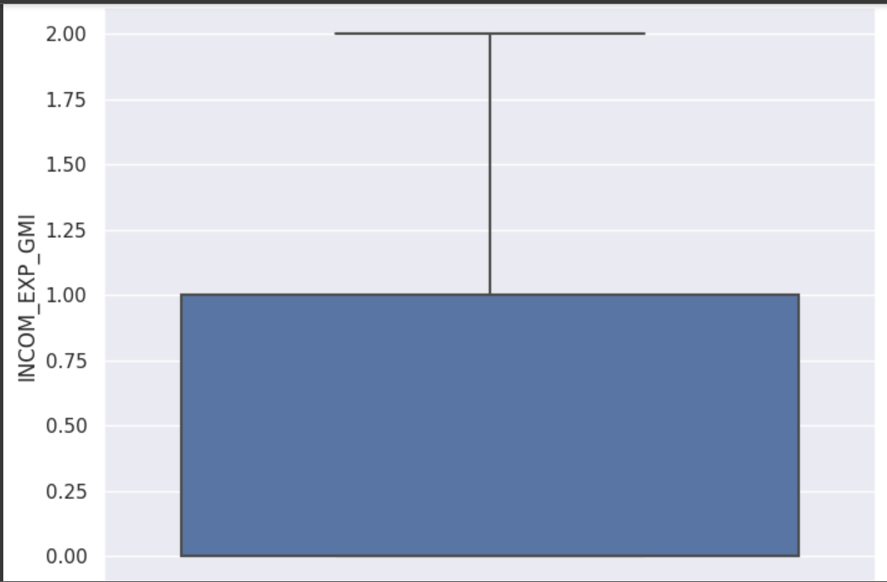
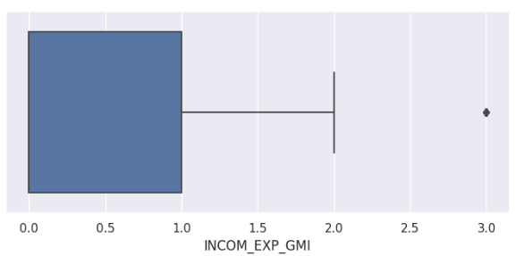
cont.
Handling Outliers: INCOM_EXP_GMI Variable
Capped outliers at value of 2 based on business reasoning
Improved model's learning by focusing on realistic financial scenarios
BEFORE
AFTER

Slide 11
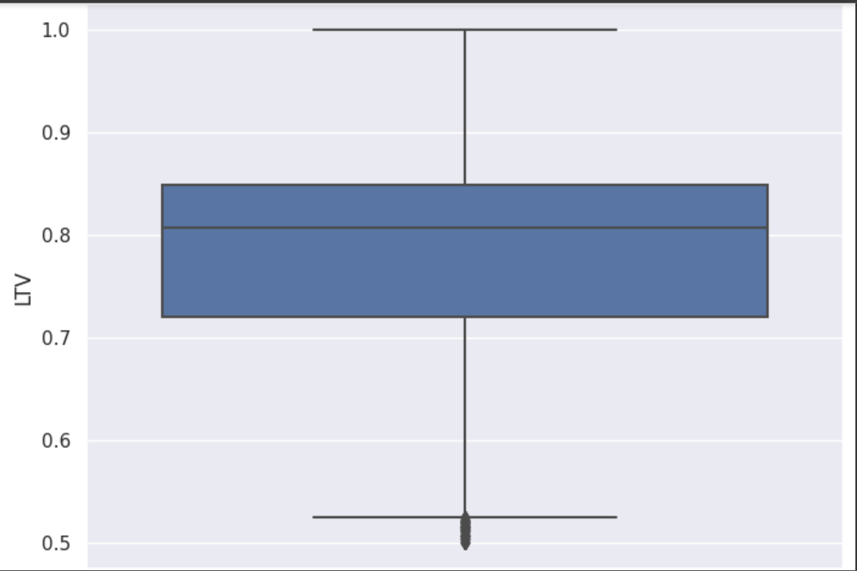
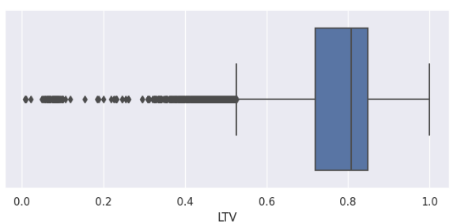
cont.
Handling Outliers: LTV Variable
Excluded LTV outliers below 0.5 as per Banking practices
Enhanced evaluation consistency and insightful analysis
BEFORE
AFTER

Slide 12
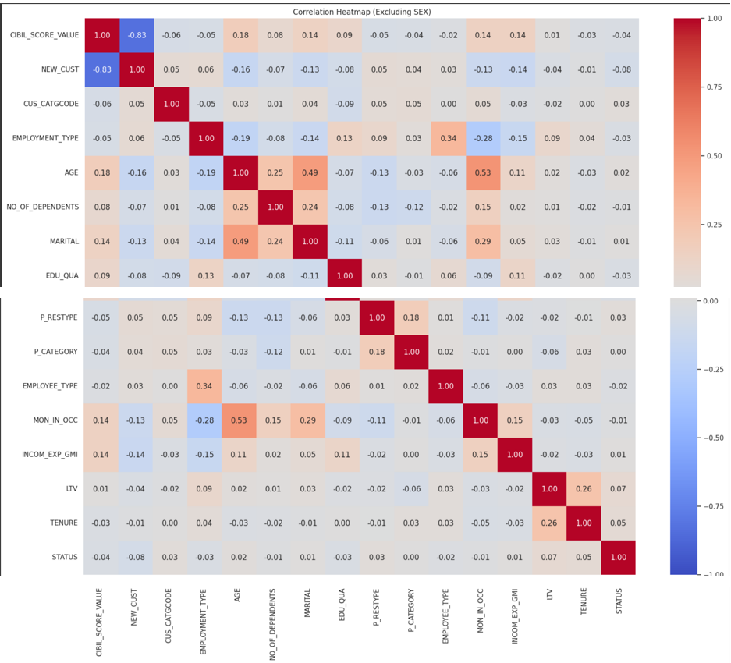
CORRELATION MAP

Slide 13
MODELS EXCECUTED
01
RANDOM FOREST
02
XGBOOST
DECISION TREE
03
parameter values:
n_estimators: [300, 350, 400, 500, 600]
max_depth: [5, 10, 15, 20, 25, 30, 35, 40]
max_features: ['auto', 'sqrt', 'log2']
min_samples_leaf: [1, 2, 4, 8]
parameter values:
n_estimators: [50, 100, 150]
learning_rate: [0.001, 0.01, 0.05, 0.1]
max_depth: [3, 5, 7, 10]
gamma: [0, 0.1, 0.2]
parameter values:
max_depth: [5, 10, 15, 20]
min_samples_split: [2, 5, 10, 20]
min_samples_leaf: [1, 2, 4, 8]
max_features: ['sqrt', 'log2']

Slide 14
ALL SCORES ARE WITHIN 0-1(0%-100%)
01
RANDOM FOREST
02
XGBOOST
03
DECISION TREE
RESULTS
 |  | SCORE
F1-SCORE | 0.6255
AUC-ROC | 0.5655
 |  | SCORE
F1-SCORE | 0. 6372
AUC-ROC | 0.678
 |  | SCORE
F1-SCORE | 0. 7297
AUC-ROC | 0.8449

Slide 15
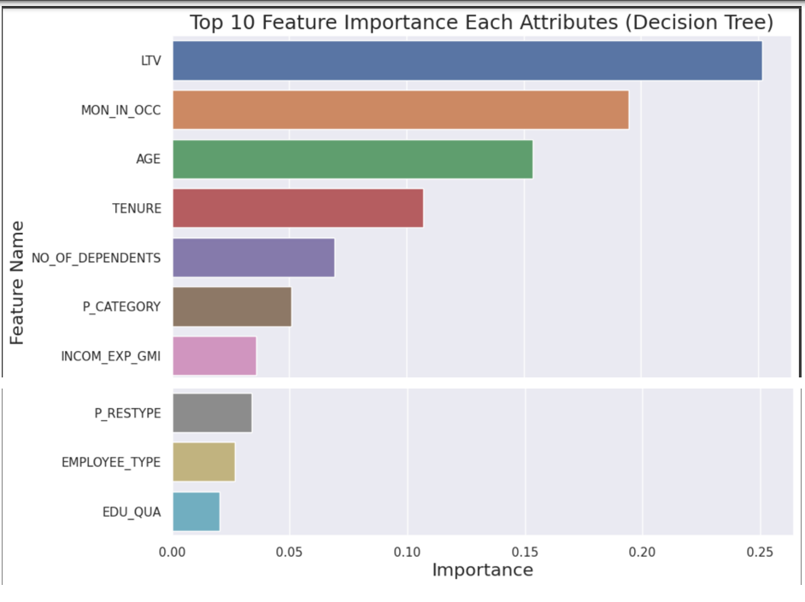
SELECTED MODEL – DECISION TREE
Model Sensitivity to Key Drivers The Decision Tree model is sensitive to key drivers, prioritizing influential features that significantly affect predictions. The top ten drivers for our model are:
LTV (Loan-to-Value ratio)
Months in Occupation (MON_IN_OCC)
Age (AGE)
Tenure (TENURE)
Number of Dependents (NO_OF_DEPENDANTS)
Type of Living Arrangements (P-CATEGORIES)
Income Expense Ratio (INCOM_EXP_GMI)
Type of Residence (P_RESTYPE)
Employee Type (EMPLOYEE_TYPE)
Highest Level of Education (EDU_QUA)
Why It Matters: The Decision Tree helps banks decide who gets a loan. It's like having a smart assistant that looks at different things before saying "yes" or "no" to a loan application.

Slide 16
RECOMMENDATION
Based on the insights gained from the analysis and the predictive model developed, I would recommend implementing the model within the loan approval process of the nationalized bank. The model has demonstrated its ability to accurately predict whether a loan application should be approved or rejected. This will enable the bank to make more informed and data-driven decisions while minimizing the risk of default and enhancing the overall customer experience.

Slide 17
Next Steps and Future Enhancements
Feature Engineering and Selection: Continuously refine and engineer features to ensure the model leverages the most relevant and up-to-date information. Carefully evaluate the importance of attributes and consider experimenting with new variables to further enhance prediction accuracy.
Addressing Bias: Implement techniques to detect and mitigate potential biases in the dataset and model predictions. Ensuring fairness in decision-making is paramount, especially in the context of loan approval, where unbiased outcomes are of utmost importance.
Regular Model Updates: Frequently monitor the model's performance and update it as new data becomes available. Adapting to changing trends and ensuring the model's relevance over time is essential for sustained success.
Continuous Monitoring and Evaluation: Incorporate regular model monitoring and evaluation procedures. This includes tracking performance metrics, identifying potential drifts, and fine-tuning the model as needed.

Slide 18
Thanks!
Any questions?

